Slide 1
Structural determination – 1(B)
Yeou-Guang Tsay, M.D., Ph.D.
Institute of Biochemistry & Molecular Biology Biomedical Industrial Ph.D. Program Biomedical EMBA Program
What properties are examined in IR?

Slide 2
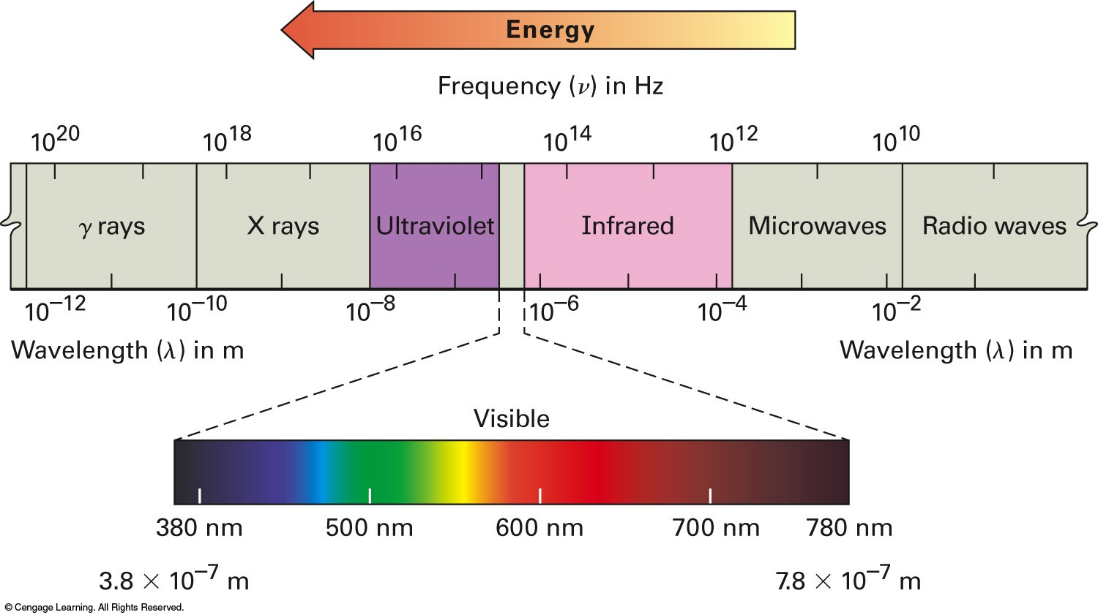
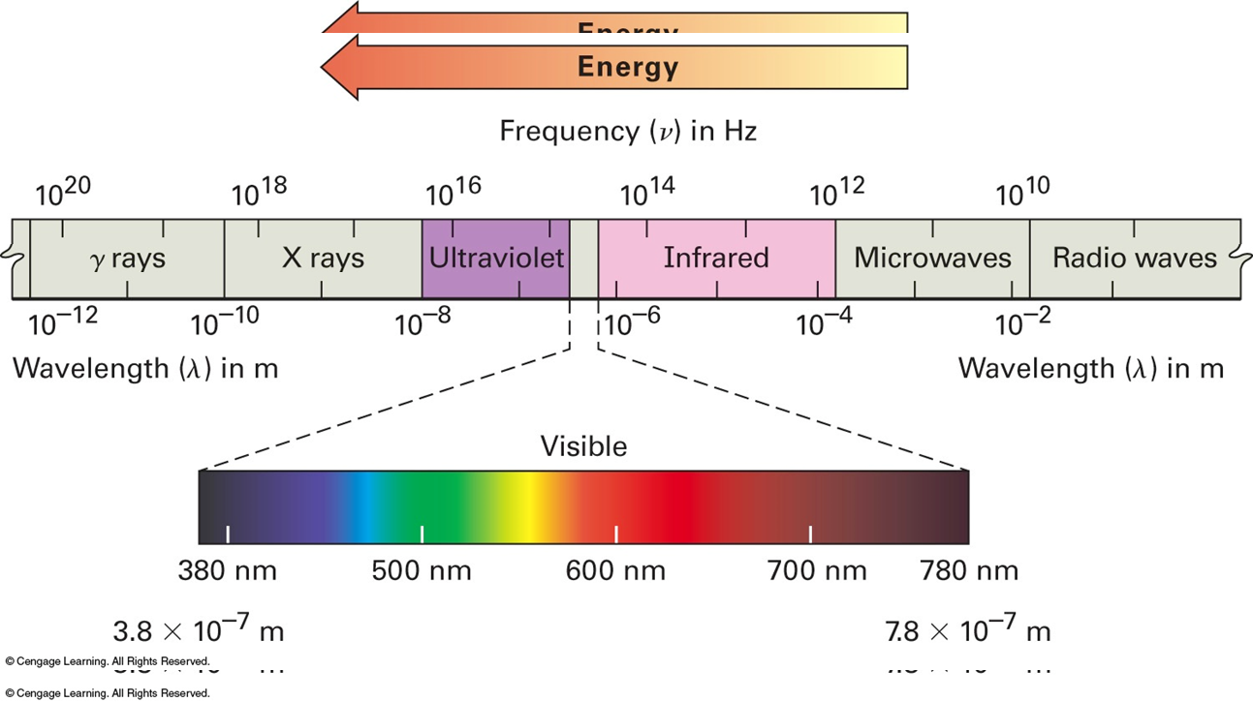
Spectroscopic analyses of organic compounds
Technique | Electromagnetic radiation | Structure
Infrared spectrometry | Infrared light | Covalent bonds
Ultraviolet spectroscopy | Ultraviolet light | σ–σ*, n–σ*, π–π*, n–π* transitions
Nuclear magnetic resonance spectroscopy | Radio wave | Atomic nuclei in magnetic field
Frequency (ν) in Hz
380 nm
780 nm
Wavelength (λ) in m

Slide 3
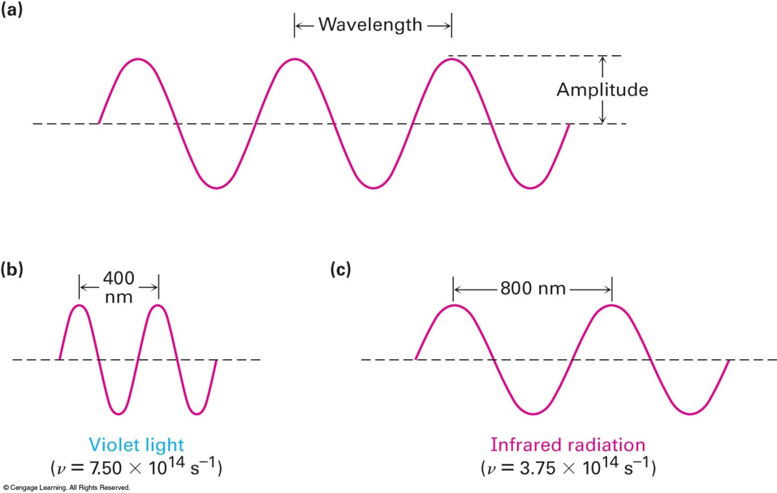
Properties of electromagnetic radiation – Wave-particle duality
Electromagnetic radiation has dual properties.
Wave properties - In homogeneous media, electromagnetic radiation is a transverse wave, meaning that its oscillations are perpendicular to the direction of energy transfer and travel
Wavelength (λ)
Amplitude
Light speed
C = λ∙ν = 2.998 × 10⁸ m/sec
Frequency (sec⁻¹ = Hz)
Particle properties - The particle of light has the name photon, like other particles such as the electron and proton. Thus, a photon is a single quantum of light

Slide 4
Quantum (plural: quanta)
The minimum amount of any physical property involved in an interaction. This means that the magnitude of the physical property can take on only discrete values consisting of integer multiples of one quantum.
Frequency (sec⁻¹ = Hz)
Wavelength (λ)
A photon, or any other form of electromagnetic radiation, has the quantum of energy (ε) that is in direct proportional to its frequency (ν)
ε = h∙ν
Planck constant
6.62607015 × 10⁻³⁴ J⋅s
E = N_{A} × ε = 4 × 10⁻¹⁰ ∙ ν (J⋅s/mol)

Slide 5

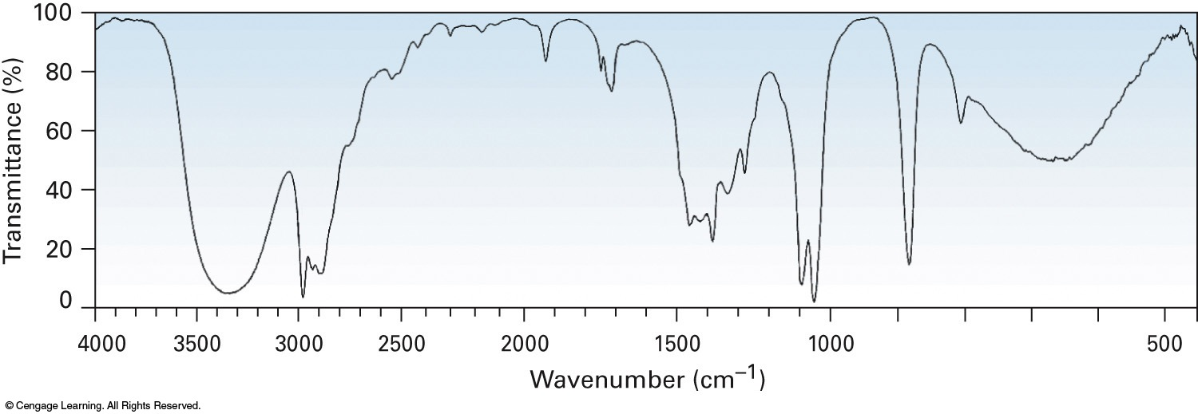

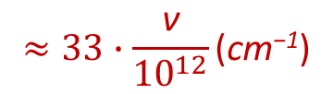
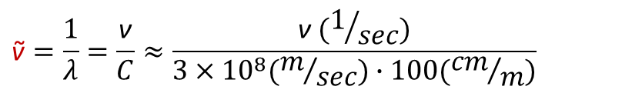
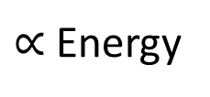
Infrared spectroscopy
$$\text{ṽ}=\frac{1}{λ}=\frac{\text{ν}}{C}≈\frac{\text{ν} (1/{sec})}{3×{10}^{8}(m/{sec})∙100({cm}/m)}$$
$$≈33∙\frac{\text{ν}}{{10}^{12}}\text{(}\text{cm}\text{−1}\text{)}$$
(ν; sec⁻¹ = Hz)
Frequency
(3333)
10¹⁴
(333)
10¹³
(33)
10¹²
$∝$ Energy
Near
Far
10⁻⁶
10⁻⁵
10⁻⁴
Wavelength (λ; m)
100
80
60
Transmittance (%)
40
20
CH₃OH
0
4000
3500
3000
2500
2000
1500
1000
500
100% at top
Wavenumber (ṽ; cm⁻¹)
$∝$Frequency
What structures absorb the energy in IR?

Slide 6
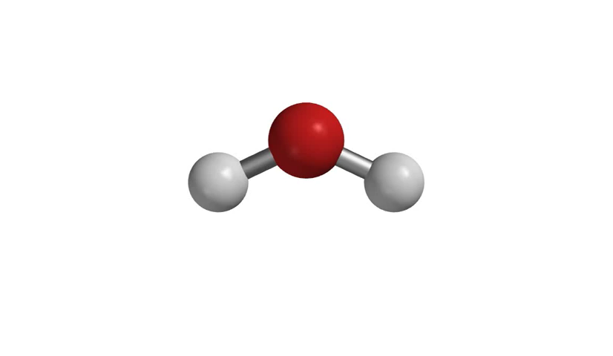
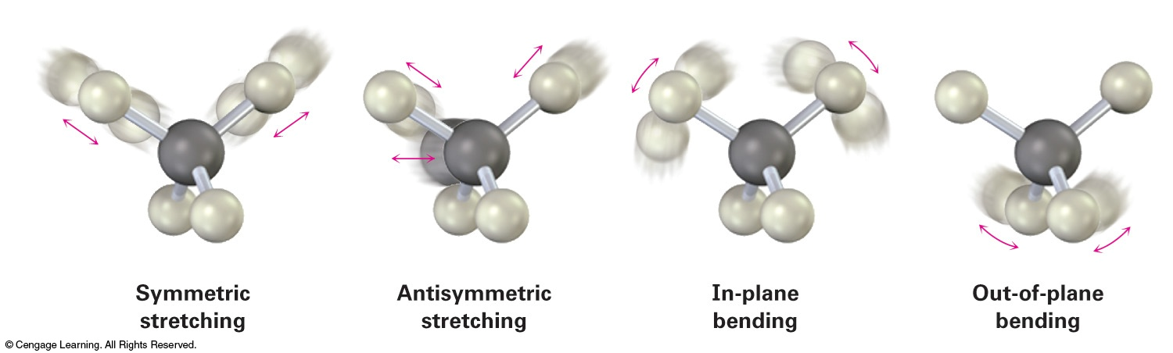
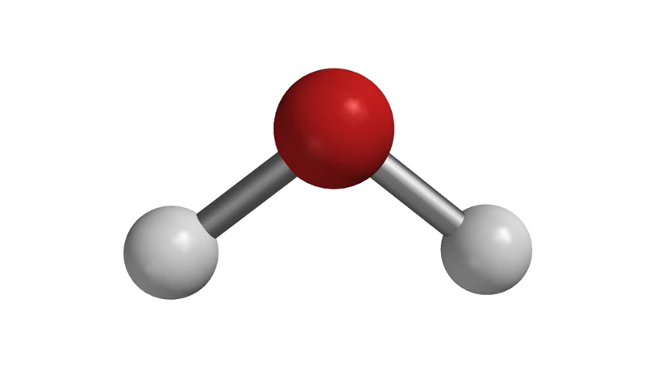
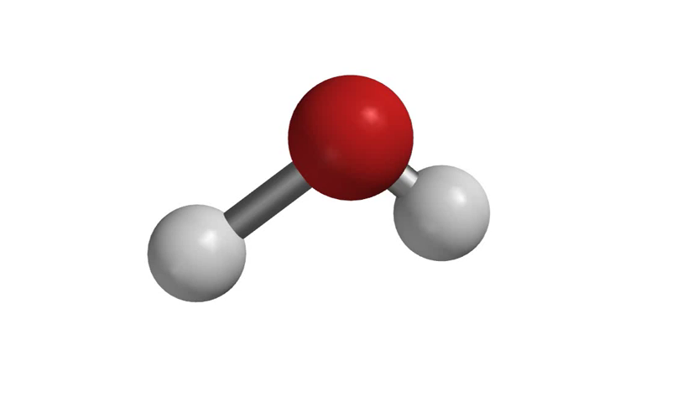
The absorption of infrared quanta causes vibration of covalent bonds
Upon absorption of the infrared radiation of a specific frequency, molecules stretch or bend if the frequency of the radiation matches the frequency of the vibration
Symmetric stretching
Antisymmetric stretching
In-plane bending
Out-of-plane bending
How do we interpret the IR spectra?

Slide 7
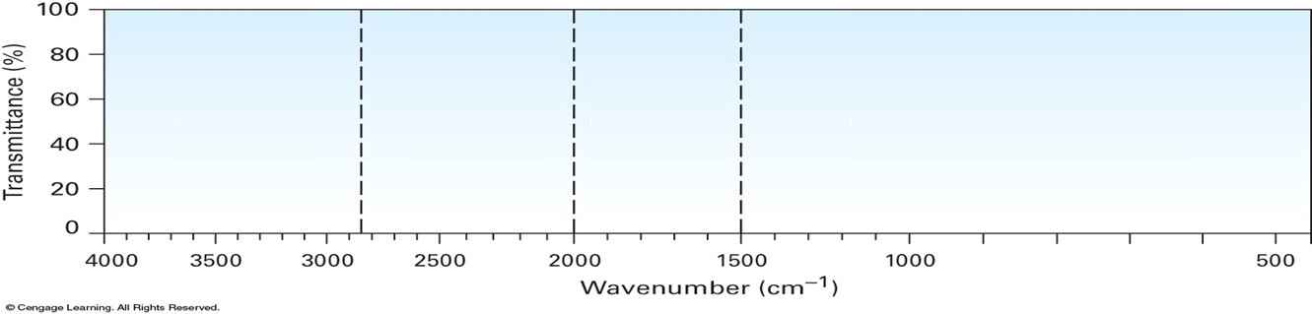
Interpret infrared spectra
Most functional groups have characteristic IR absorption bands that do not change from one compound to another
2850
2000
1500
100
80
O−H
N−H
C−H
C=O
C=N
C=C
60
C≡N
C≡C
Fingerprint
Transmittance (%)
40
20
CH₃OH
0
4000
3500
3000
2500
2000
1500
1000
500
Wavenumber (ṽ; cm⁻¹)

Slide 8
^{N}P2, ^{N}P3
Infrared absorption frequencies in organic chemistry
=C−H
C=C
Φ Ring bonds
≡C−H
C−H
C≡C
=C−H
O−H (Carboxylic acid)
N−H
C−H
O
O−H
(alcohol)
=
C≡N
C=O
C=N
NO₂
4000
3500
3000
2500
2000
1500
1000
500

Slide 9
^{N}P2
Infrared absorption frequencies of hydrocarbons
=C−H
C=C
Φ Ring bonds
≡C−H
C−H
C≡C
=C−H
4000
3500
3000
2500
2000
1500
1000
500
Group | Class | Frequency, cm⁻¹ | Signal | Group | Class | Frequency (cm⁻¹) | Signal
C-H | Alkane | 2850-2960 | M | ≡C-H | Alkyne | 3300 | S
=C-H | Alkene | 3020-3100 | M | C≡C | Alkyne | 2100-2260 | M
C=C | Alkene | 1640-1680 | M | =C-H | Arene | 3030 | W
W: weak, M: medium, S: strong |  |  |  | Φ Ring bonds | Arene | 1450-1600 | M
✓
2

Slide 10
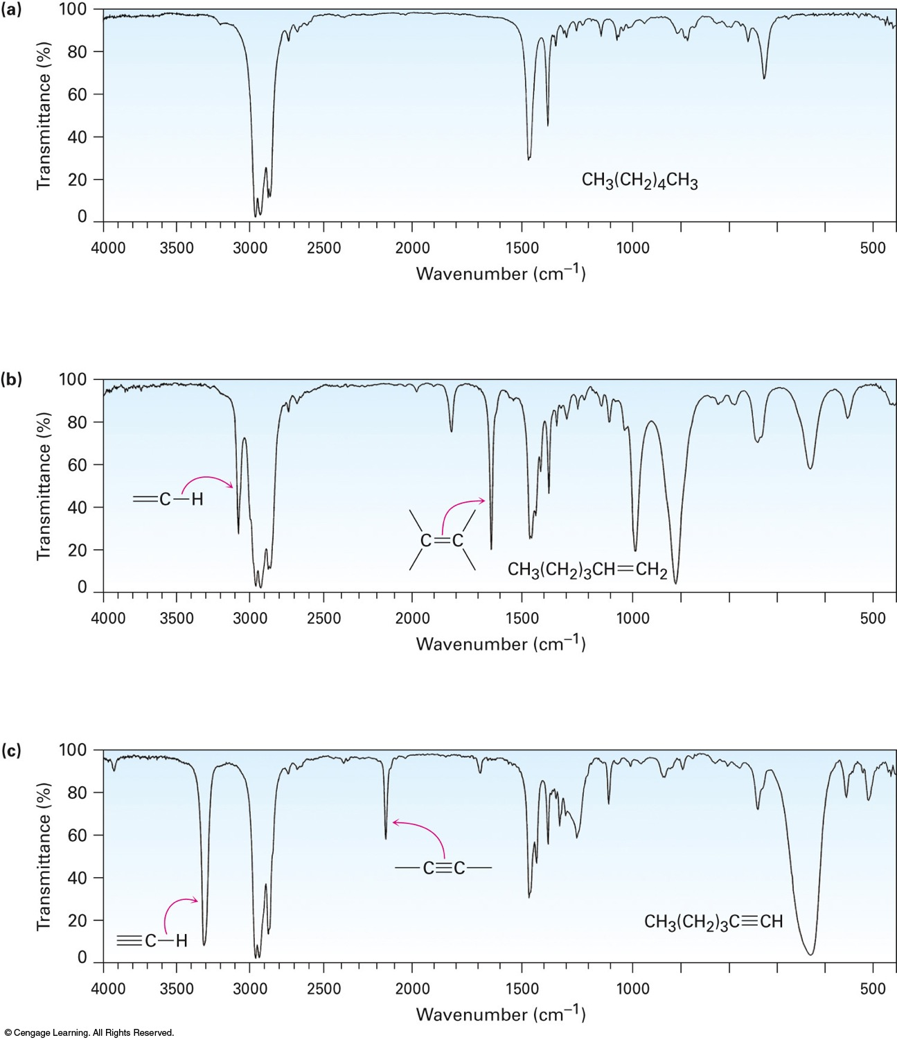
IR characteristics in alkane, alkene and alkyne
✓
80
-C-H
2850-2960
40
An alkane
CH₃(CH₂)₄CH₃
0
✓
✓
80
40
=C-H
C=C
An alkene
Transmittance (%)
3020-3100
1640-1680
CH₃(CH₂)₃CH=CH₂
0
✓
✓
80
40
≡C-H
2100-2260
An alkyne
3300
C≡C
CH₃(CH₂)₃C≡CH
0
4000
3500
3000
2500
2000
1500
1000
500
Wavenumber (ṽ; cm⁻¹)

Slide 11
^{N}P2
Infrared absorption frequencies of hydrocarbons
=C−H
C=C
Φ Ring bonds
≡C−H
C−H
C≡C
=C−H
4000
3500
3000
2500
2000
1500
1000
500
Bond | Class | Frequency, cm⁻¹ | Signal | Bond | Class | Frequency (cm⁻¹) | Signal
C-H | Alkane | 2850-2960 | M | ≡C-H | Alkyne | 3300 | S
=C-H | Alkene | 3020-3100 | M | C≡C | Alkyne | 2100-2260 | M
C=C | Alkene | 1640-1680 | M | =C-H | Arene | 3030 | W
W: weak, M: medium, S: strong |  |  |  | Φ Ring bonds | Arene | 1450-1600 | M
3
2
✓
✓
1½

Slide 12
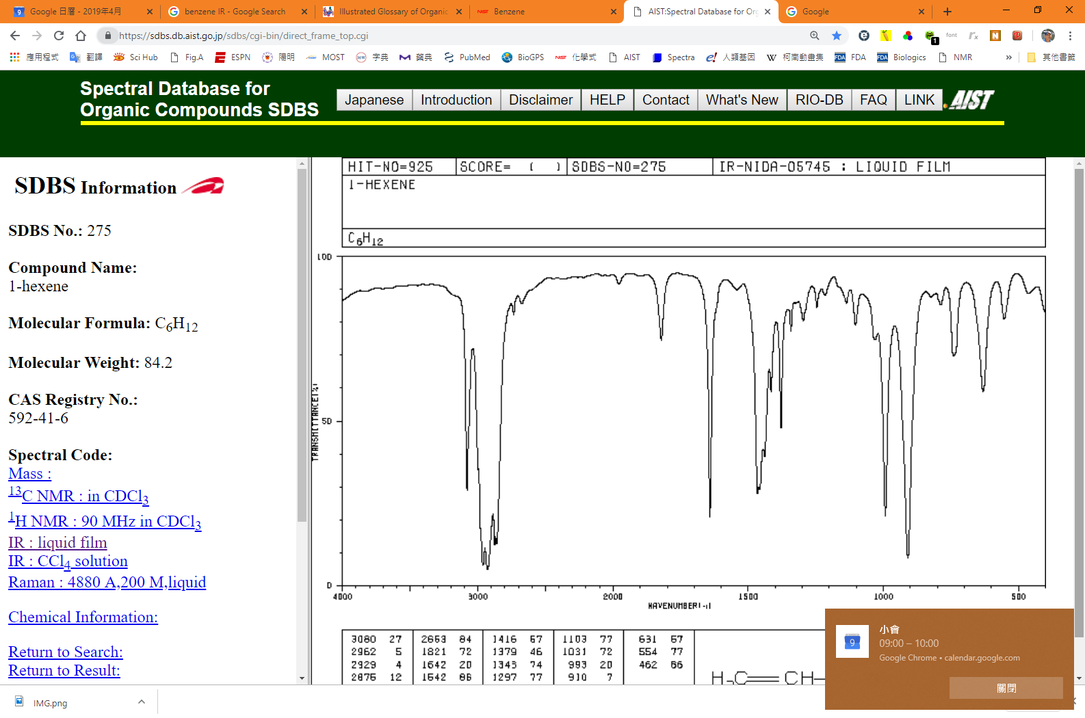
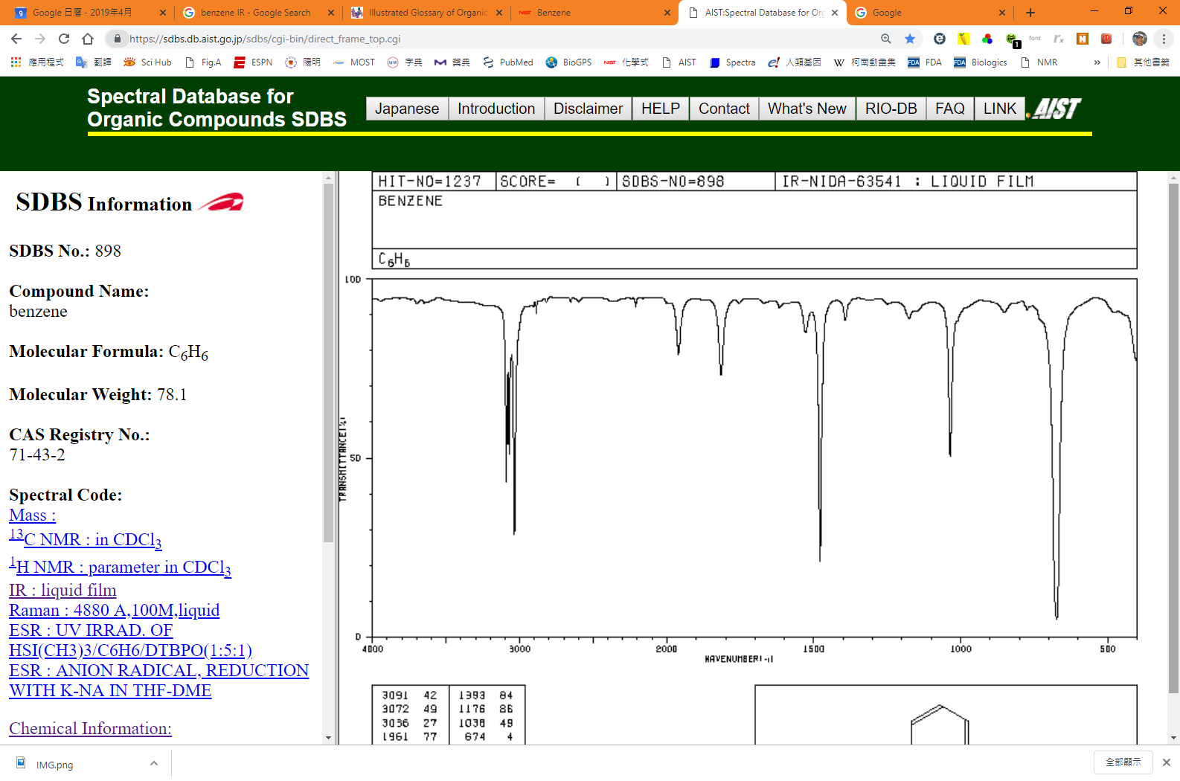
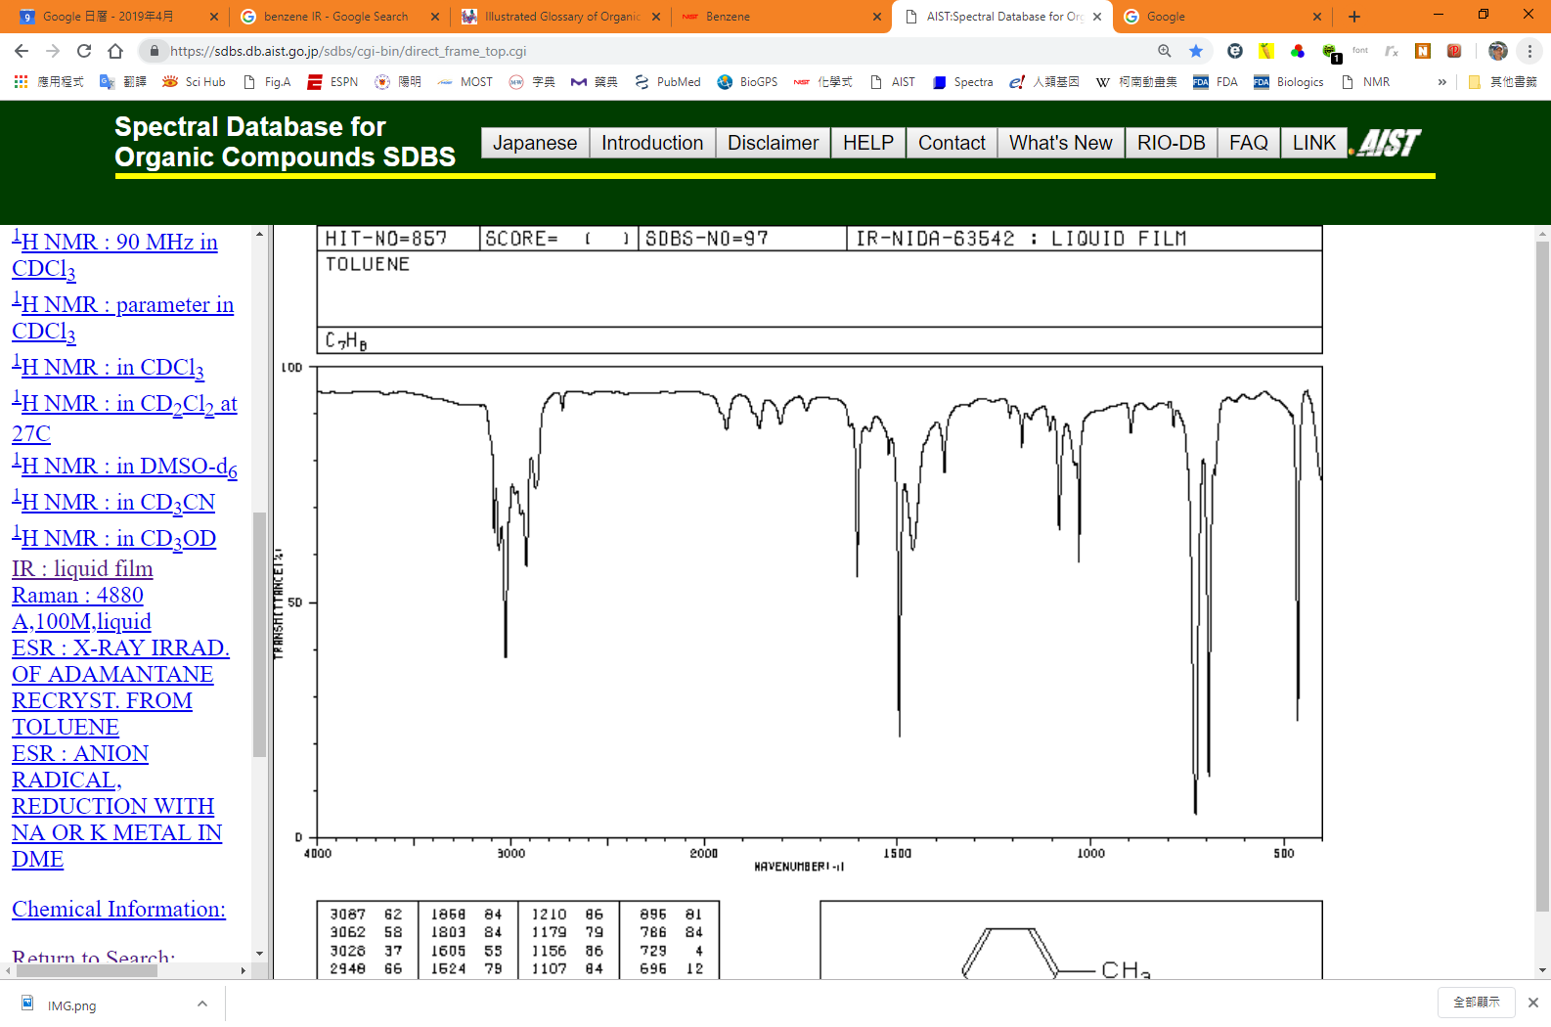
IR characteristics in arenes versus alkene
✓
✓
100
50
=C-H
C=C
3020-3100
1640-1680
CH₃(CH₂)₃CH=CH₂
0
✓
✓
100
Transmittance (%)
50
=C-H
Φ Ring bonds
C=C
C₆H₆ (Benzene)
3030
1450-1600
0
✓
✓
100
✓
50
=C-H
C=C
Φ Ring bonds
C=C
C₆H₅-CH₃ (Toluene)
3030
1450-1600
0
4000
3500
3000
2500
2000
1500
1000
500
Wavenumber (ṽ; cm⁻¹)

Slide 13
Infrared absorption frequencies of oxygen-containing substances
^{N}P3
O−H (Carboxylic acid)
N−H
C−H
O
O−H
(alcohol)
=
C≡N
C=O
C=N
NO₂
4000
3500
3000
2500
2000
1500
1000
500
Bond | Functional class | Frequency cm⁻¹ | Signal | Bond | Class | Frequency cm⁻¹ | Signal
O-H | Alcohol | 3400-3650 | S&B | N-H | Amine | 3300-3500 | M
O-H | Carboxylic acid | 2500-3100 | S&B | C=N | Imine | 1610-1690 | S
=C-H | Aldehyde | 3020-3100 | M | C≡N | Nitrile | 2210-2260 | M
C=O | Aldehyde, ketone, ester, amide and carboxylic acid | 1670-1780 | S | NO₂ | Nitro | 1540 | S
 |  |  |  | W: weak, M: medium, S: strong

Slide 14
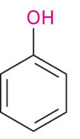
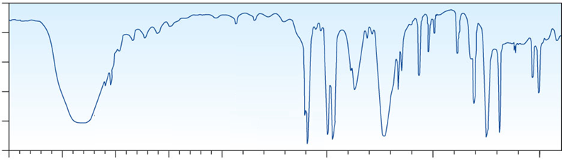
Infrared spectroscopy – phenol
3400~3650 cm⁻¹ (Strong, broad)
H-O stretching
✓
100
✓
✓
80
✓
60
Transmittance (%)
40
Φ Ring bonds
20
C=C
1450-1600
C=C
4000
3000
2000
1500
1000
500
Wavenumber

Slide 15
Infrared spectroscopy – alcohol
H-O stretching
3400~3650 cm⁻¹ (Strong, broad)
100
80
60
Transmittance (%)
40
20
4000
3000
2000
1500
1000
500
Wavenumber

Slide 16
Infrared absorption frequencies of oxygen-containing substances
^{N}P3
O−H (Carboxylic acid)
N−H
C−H
O
O−H
(alcohol)
=
C≡N
C=O
C=N
NO₂
4000
3500
3000
2500
2000
1500
1000
500
Bond | Functional class | Frequency cm⁻¹ | Signal | Bond | Class | Frequency cm⁻¹ | Signal
O-H | Alcohol | 3400-3650 | S&B | N-H | Amine | 3300-3500 | M
O-H | Carboxylic acid | 2500-3100 | S&B | C=N | Imine | 1610-1690 | S
=C-H | Aldehyde | 3020-3100 | M | C≡N | Nitrile | 2210-2260 | M
C=O | Aldehyde, ketone, ester, amide and carboxylic acid | 1670-1780 | S | NO₂ | Nitro | 1540 | S
 |  |  |  | W: weak, M: medium, S: strong

Slide 17
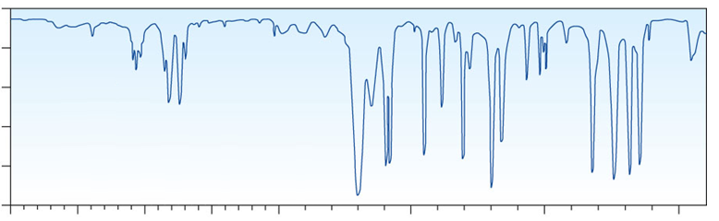
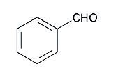
Infrared spectroscopy - aldehyde
100
✓
✓
✓
✓
80
sp2 C-H
60
3020-3100 cm⁻¹
Transmittance (%)
40
20
C=O
C=C
Φ Ring bonds
C=C
1670-1780
1450-1600
4000
3000
2000
1500
1000
500
Wavenumber

Slide 18
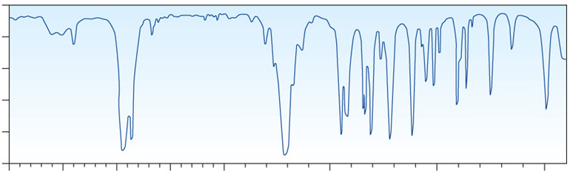
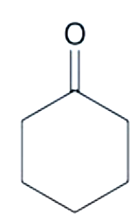
Infrared spectroscopy - ketone
100
✓
80
60
Transmittance (%)
40
20
C=O
1670-1780
4000
3000
2000
1500
1000
500
Wavenumber

Slide 19
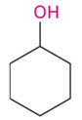
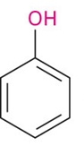
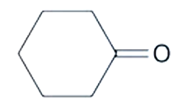
Infrared spectroscopy of alcohols, phenols, aldehydes and ketones
Φ Ring bonds
O-H
O-H
sp2 C-H
Φ Ring bonds
C=O
C=O

Slide 20
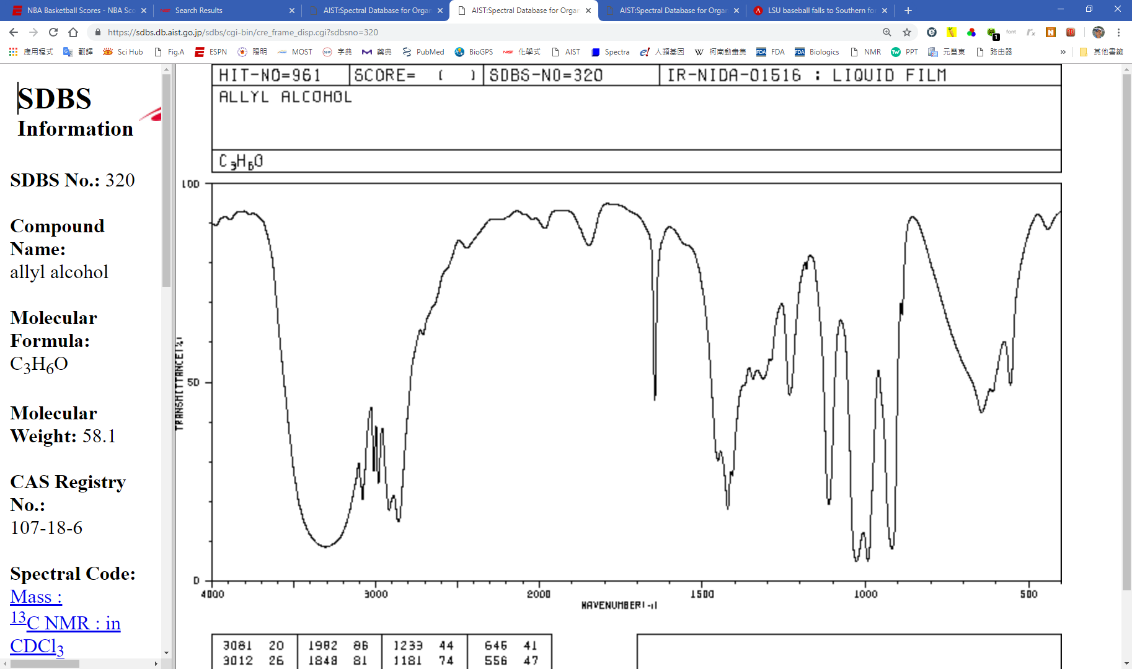
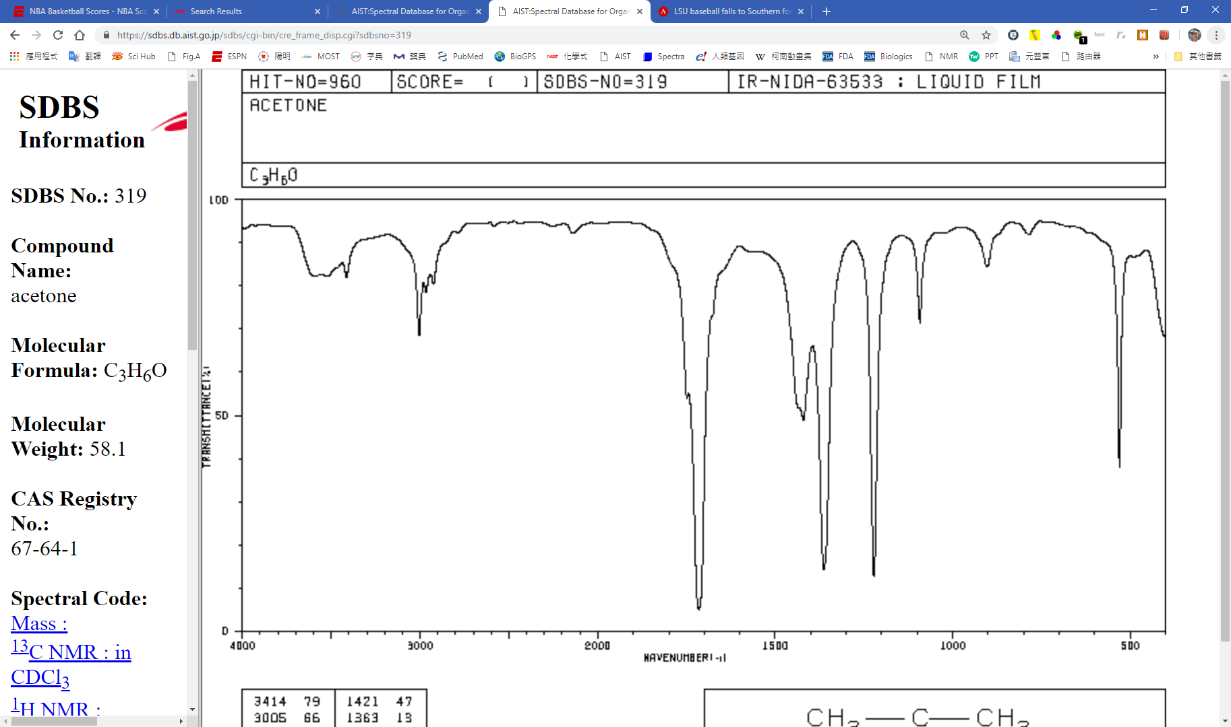
How to use infrared spectroscopy to distinguish two compounds with the same chemical formula C₃H₆O?
Acetone
CH₃COCH₃
Prop-2-en-1-ol
H₂C=CHCH₂OH
1640-1680
vs
1670-1780
3400-3650 (Broad)
100
50
Prop-2-en-1-ol
0
100
Transmittance (%)
50
Acetone
0
4000
3500
3000
2500
2000
1500
1000
500
Wavenumber (ṽ; cm⁻¹)

Slide 21
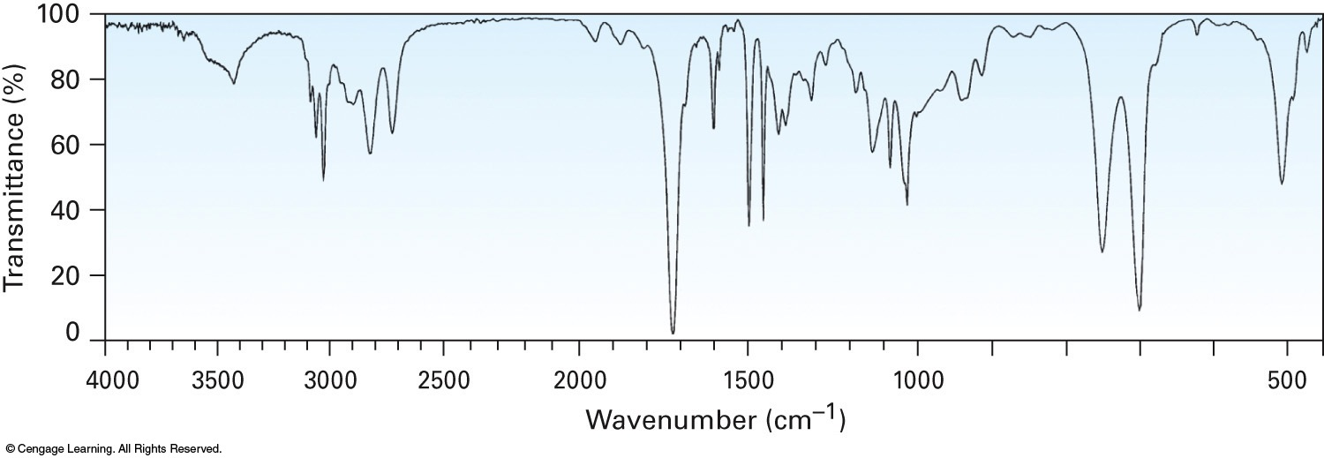
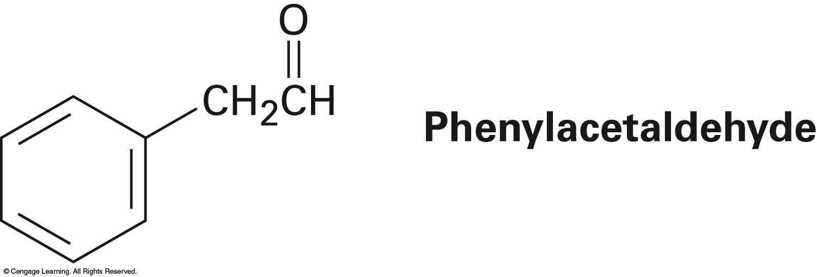
How to predict the structure based on infrared spectroscopy?
100
80
60
Φ Ring bonds
Transmittance (%)
40
sp2 C-H
Φ Ring bonds
20
C=O
Strong
0
4000
3500
3000
2500
2000
1500
1000
500
Wavenumber (ṽ; cm⁻¹)
The table will be given in my test. Learn how to find the needed info from the table
Aldehyde
Aromatic ring

Slide 22
Spectroscopic analyses of organic compounds
= S2
Technique | Electromagnetic radiation | Structure
Infrared spectrometry | Infrared light | Covalent bonds
Ultraviolet spectroscopy | Ultraviolet light | σ–σ*, n–σ*, π–π*, n–π* transitions
Nuclear magnetic resonance spectroscopy | Radio wave | Atomic nuclei in magnetic field
Frequency (ν) in Hz
380 nm
780 nm
Wavelength (λ) in m

Slide 23
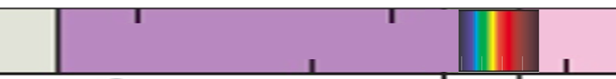
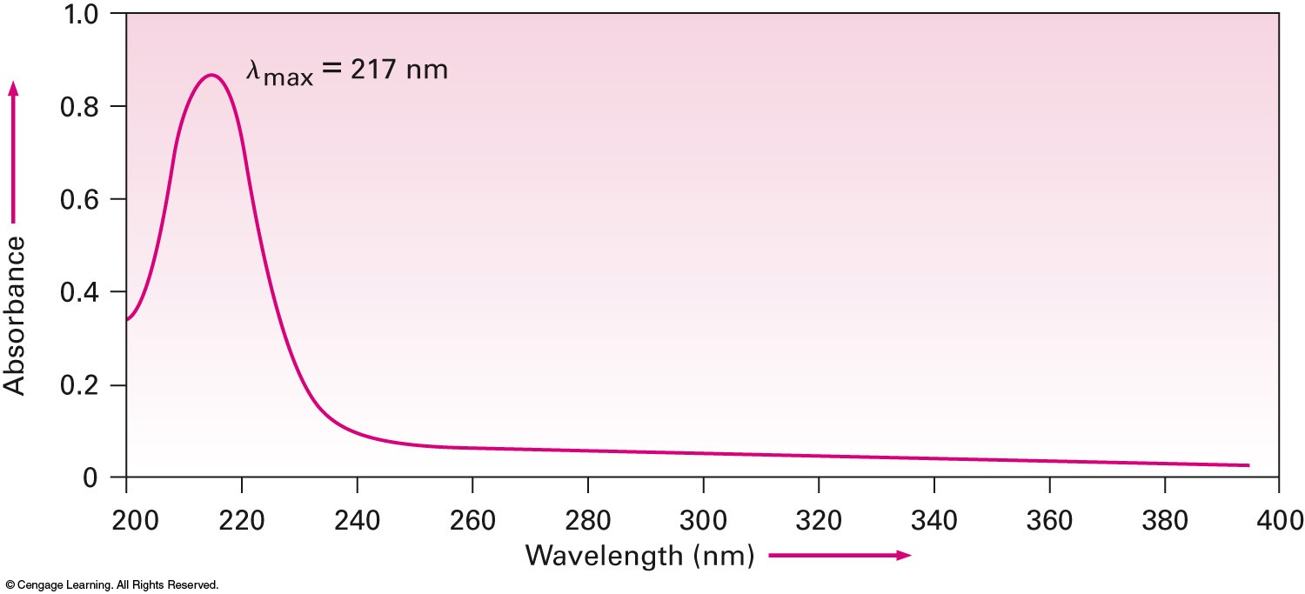
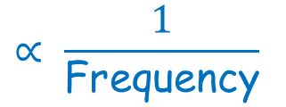
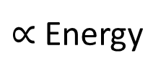
Ultraviolet spectroscopy
(ν; sec⁻¹ = Hz)
Frequency
10¹⁶
10¹⁵
10¹⁴
$∝$ Energy
Ultraviolet
10⁻⁸
10⁻⁷
10⁻⁶
Wavelength (λ; m)
1.0
UV
Vis
0.8
λ_{max} = 217 nm
0.6
Conjugated diene
Absorbance
CH₂=CH-CH=CH₂
0.4
0.2
(Buta-1,3-diene)
0.0
200
220
240
260
280
300
320
340
360
380
400
0 at bottom
>200 nm
Wavelength (nm)
$$∝ \frac{1}{\text{Frequency}}$$
What compounds have a peak in the UV spectrum?

Slide 24
Ultraviolet spectroscopy
Ultraviolet spectroscopy refers to absorption spectroscopy or reflectance spectroscopy in part of the ultraviolet spectral regions. In this region of the electromagnetic spectrum, atoms and molecules undergo electronic transitions. Absorption spectroscopy measures transitions from the ground state to the excited state.
Molecules containing bonding (σ- and π-electrons) or non-bonding electrons (n-electrons) can absorb energy in the form of ultraviolet to excite these electrons to higher anti-bonding molecular orbitals.
The more easily excited the electrons, (i.e. lower energy gap between the HOMO and the LUMO), the longer the wavelength of light it can absorb
Highest Occupied MO
Lowest Unoccupied MO
What properties are examined in UV-Vis?
Energy gap between HOMO and LUMO

Slide 25
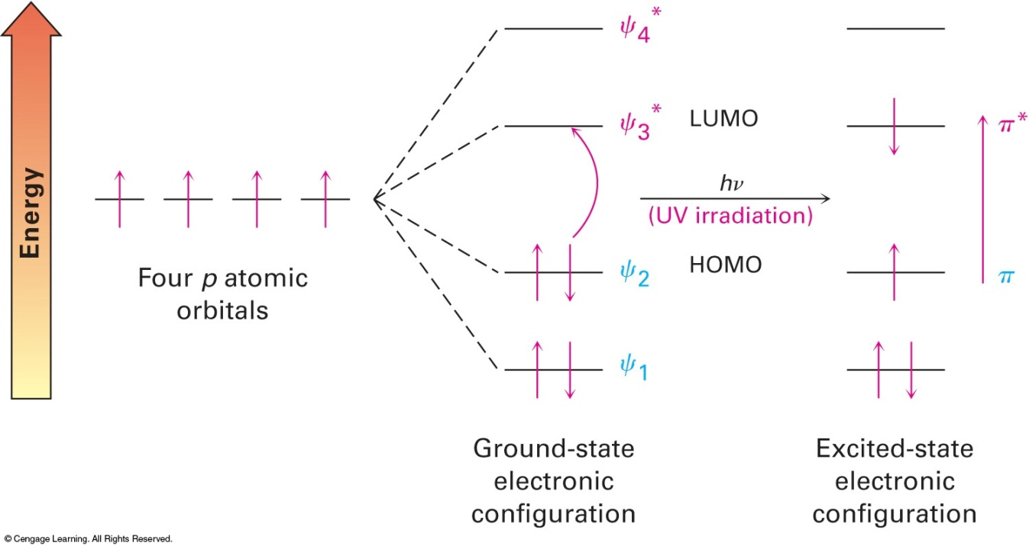
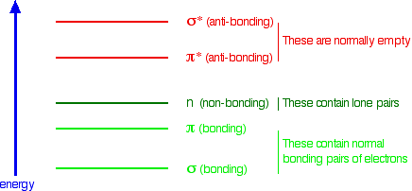
Various HOMO-LUMO transitions leading to ultraviolet absorption
^{N}P5
σ* (Antibonding)
π* (Antibonding)
^{N-, O-}
n (nonbonding)
π (bonding)
σ (bonding)
σ–σ* > n–σ* > π–π* > n–π*

Slide 26
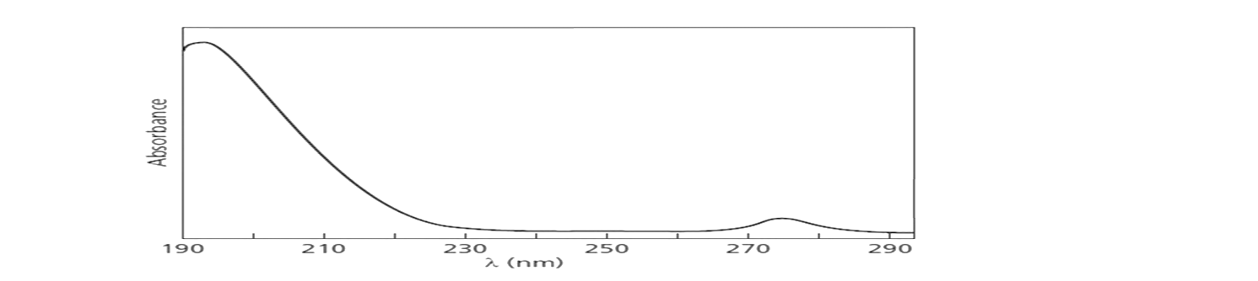
Ultraviolet spectroscopy of acetone
vs 165 nm for ethene
σ* (antibonding)
π* (antibonding)
n
195 nm
275 nm
:
:
n (nonbonding)
O
π (bonding)
σ + π
=
H₃CCCH₃
σ (bonding)
π–π*
n–π*
1.0
π–π* transition
0.8
Weak signal but quite distinct
λ_{max} = 195
0.6
Absorbance
0.4
λ_{max} = 275
0.2
n–π* transition
0.0
200
220
240
260
Wavelength (nm)
What structure can narrow the energy gap between HOMO and LUMO?

Slide 27
π–π* transition for buta-1,3-diene
A conjugated diene
Ψ₄*
Lowest unoccupied
Ψ₃*
LUMO
π*
π*
hν
217 nm
UV irradiation
Ψ₂
HOMO
π
π
Highest occupied
vs ethene 165 nm
Ψ₁
Ground state electronic configuration
Excited state electronic configuration
Four 2p atomic orbitals (AO)
Four Ψ molecular orbitals (MO)

Slide 28
UV absorption in conjugated polyenes
Ψ₈*
Ψ₄*
Ψ₆*
Ψ₇*
Ψ₂*
Ψ₅*
Ψ₆*
Ψ₃*
Ψ₄*
Ψ₅*
LUMO
165 nm
217 nm
258 nm
290 nm
Ψ₃
Ψ₄
HOMO
Ψ₂
Ψ₃
Ψ₁
Ψ₂
Ψ₂
Ethene
Ψ₁
Ψ₁
Ψ₁
n–π* 320 nm
Buta-1,3- diene
All have similar λ_{max}
Hexa-1,3,5- triene
Octa-1,3,5,7- tetraene
(219 nm)
H₃C
H₂C=CH-C=O
Enone
As the number of conjugated C=C becomes higher, the energy gap between HOMO and LUMO decreases and the wavelength of absorbed light increases
(220 nm)
H₃C
H₂C=CH-C=CH₂
H₂C=CH-HC=CH₂
(217 nm)

Slide 29
UV absorption in cyclic vs linear conjugation
Ψ₆*
Ψ₆*
Ψ₂*
Ψ₅*
Ψ₄*
Ψ₄*
LUMO
Ψ₅*
.
Antibonding
165 nm
258 nm
203 nm
Bonding
Ψ₃
HOMO
Ψ₂
Ψ₃
Ψ₁
Ψ₂
Ethene
Ψ₁
Ψ₁
Hexa-1,3,5- triene
Benzene
Cyclic conjugation may give a peak with λ_{max} > 200 nm in UV spectra as well

Slide 30
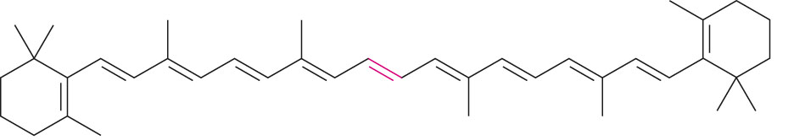
Colors of organic compounds result from extensive conjugation
As the number of conjugated C=C becomes higher, the energy gap between HOMO and LUMO decreases. When the wavelength of absorbed light is in the range of visible light, the compound should become colored
β-Carotene has λ_{max} = 455 nm. When white light strikes β-carotene, wavelengths in the blue region are absorbed. Thus, the yellow-orange colors are transmitted to our eyes
β-Carotene
Retinol production

Slide 31
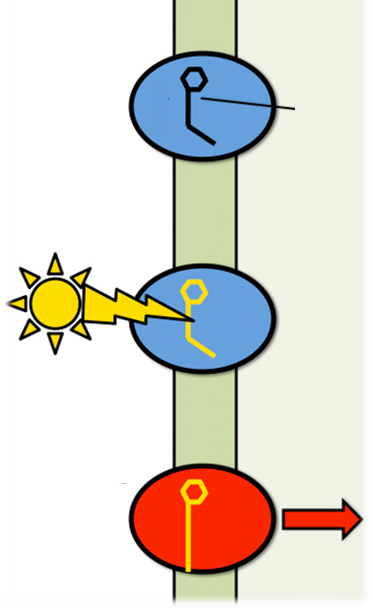
A vitamers in visual cycle
In retina
Cell membrane
11-cis-Retinol
Outside
Inside
NAD(P)
reductase
11-cis-retinal
Dark adaptation
Opsin
11-cis-Retinal + opsin
A protein
Rhodopsin
hν
Rhodopsin
Isomerase
Isomerase
hν
All-trans-Retinal + opsin
Metarhodopsin II
Nerve excitation
NAD(P)
reductase
Ion influx
All-trans-Retinol
Metarhodopsin II
(From circulation)
Optic nerve transmission

Slide 32
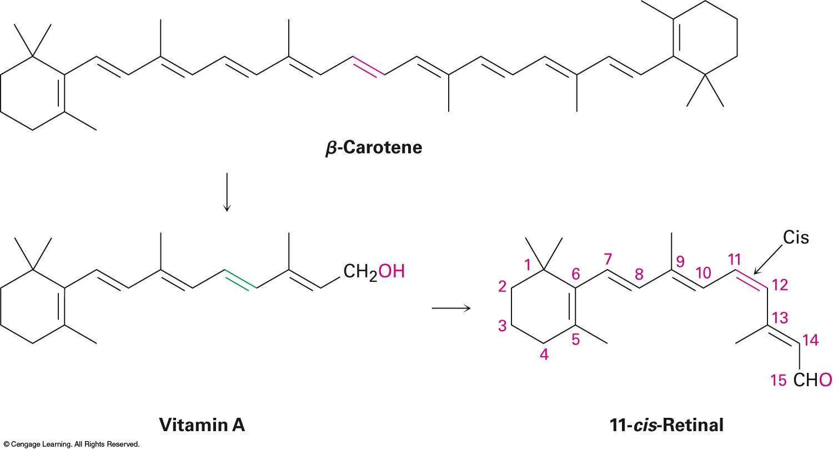
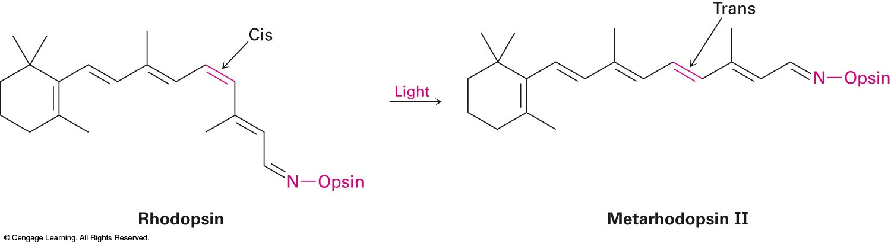
Some structures in visual cycle
All-trans-Retinol
11-cis-Retinal
Imine bond
hν
Apo-opsin
Rhodopsin
N-opsin
A protein
N-opsin
Metarhodopsin II

Slide 33
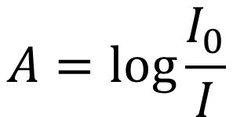
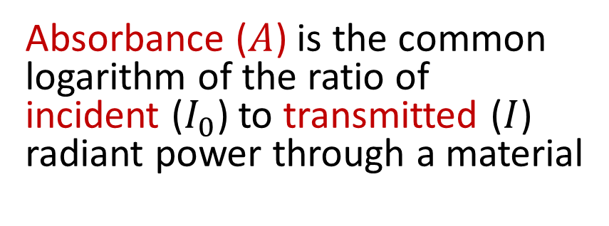
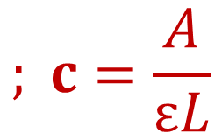
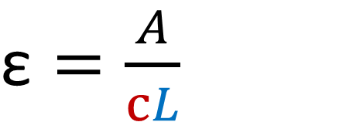
Absorbance (A) and molar absorptivity (ε)
Absorbance ($A$) is the common logarithm of the ratio of incident ($I_{0}$) to transmitted ($I$) radiant power through a material
$$A=\log{\frac{I_{0}}{I}}$$
Molar absorptivity (ε), or molar extinction coefficient, is a measure of how strongly a chemical species or substance absorbs light at a particular wavelength
$$; c=\frac{A}{εL}$$
$\text{ε}=\frac{A}{cL}$
Molar concentration
Sample pathlength (cm)

